Slide 1
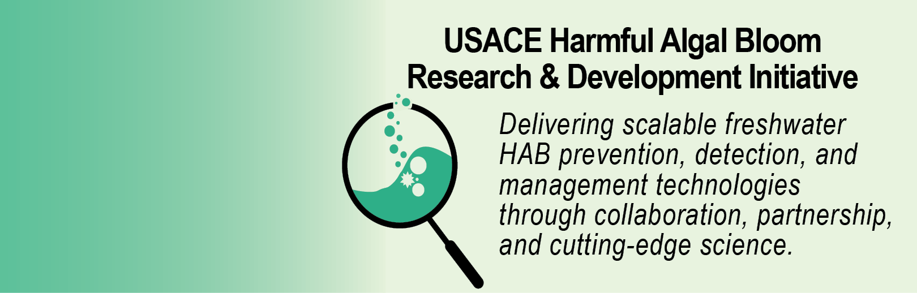
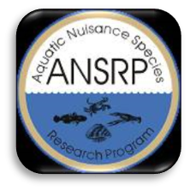

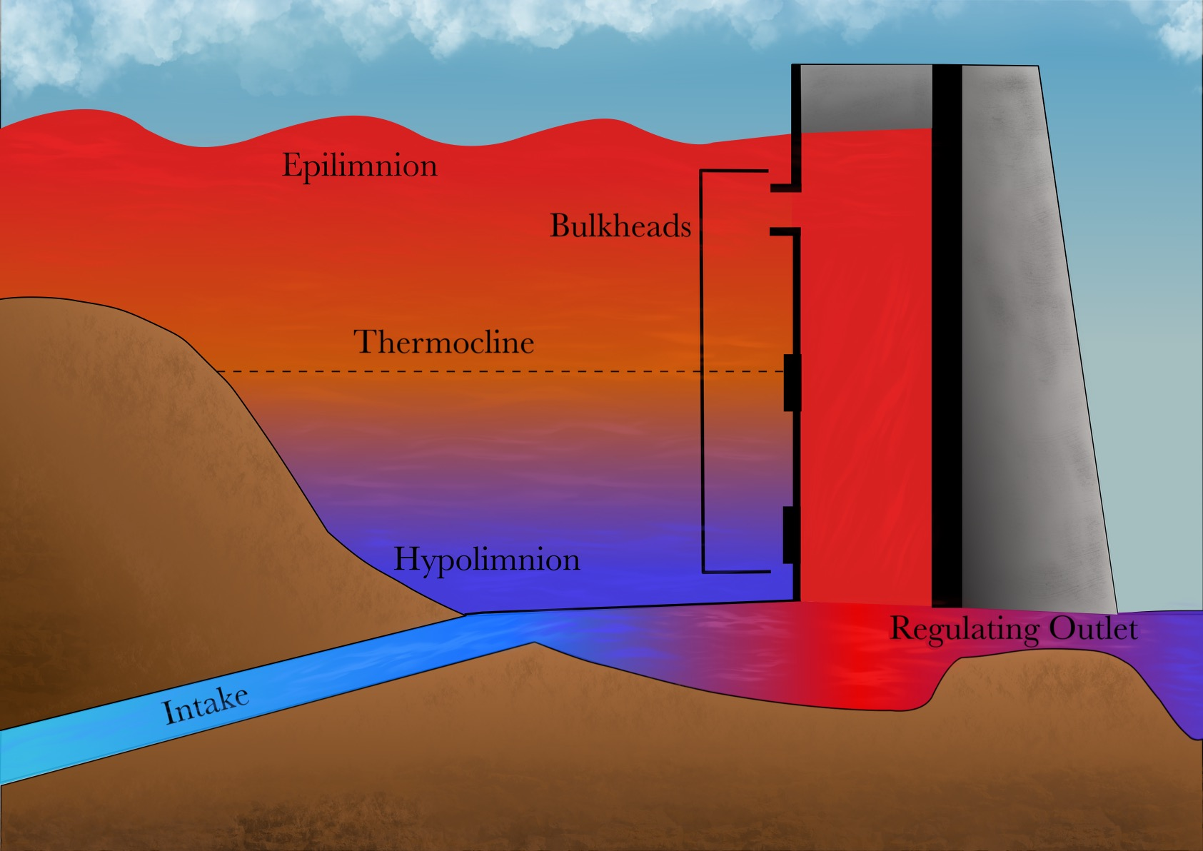
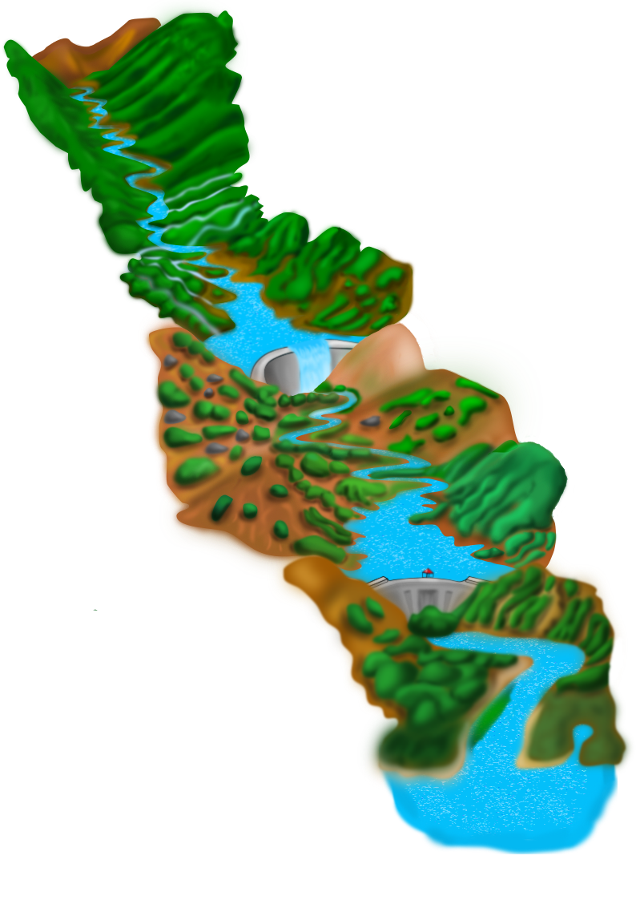
Development of a Predictive HAB Planning Tool using CE-QUAL-W2 Todd Steissberg (Todd.E.Steissberg@erdc.dren.mil, 530-574-5572), Jodi Ryder, Isaac Mudge, Lauren Melendez, Emily Summers
Problem Statement
Technical Approach Cont’d
Current models inadequately predict HAB timing, frequency, intensity, spatial variability, and impacts. A predictive HAB planning tool will be developed using ERDC’s reservoir water quality model, CE-QUAL-W2.
Task 3. Implement new HAB simulation capabilities into CE-QUAL-W2 and develop post-processing tools.
Task 4. Test new HAB simulation and prediction capabilities.
Task 5: Select demonstration site, in coordination with field partners, and gather the necessary data to validate CE-QUAL-W2 for HAB growth, transport, and decay.
Task 6: Perform demonstration study, calibrate/validate model results, compute model statistics, debug new algorithms.
Tasks 7 & 8: Technical transfer – publications and webinar
Technical Approach
Describe technical approach, highlight:
Task 1. Perform literature review of current HAB physical effects and biological behaviors and analysis of current CE-QUAL-W2 capabilities and limitations. Product: Technical Report
Go/no go point: Determine which methods and species to target for design.
Task 2. Develop a design plan for implementing new simulation algorithms into CE-QUAL-W2 and developing post-processing analysis tools.
Deliverables & Schedule
Tech Report. “Current Capabilities and Opportunities for Numerical Water Quality Modeling of Harmful Algae Blooms”, Q2/FY24
Upgraded CE-QUAL-W2 model and tools with HAB capabilities, Q4/FY24
Tech Note. “Design of a Predictive HAB Planning Tool using CE-QUAL-W2”, Q4/FY24
Journal Article. “A Predictive Harmful Algal Bloom Planning Tool using CE-QUAL-W2”, Q2/FY25
ANSRP Harmful Algal Bloom Congressional Interest In-Progress Review

Slide 2
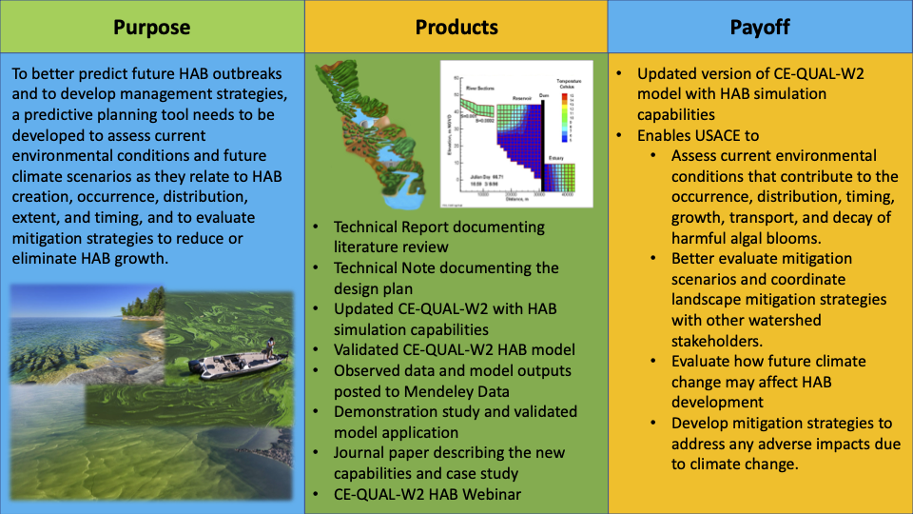
Development of a Predictive HAB Planning Tool using CE-QUAL-W2 Todd Steissberg (Todd.E.Steissberg@erdc.dren.mil, 530-574-5572), Jodi Ryder, Isaac Mudge, Lauren Melendez, Emily Summers
Value to USACE Operations
CE-QUAL HAB models will enable USACE to assess environmental conditions that contribute to the growth, transport, and decay of HABs. They will show the spatial response and variability of HABs, evolving over short time scales, informing mitigation planning and response.
Deliverables by Year
Literature review, FY23
Technical report on literature review and model and algorithm analysis, FY24
Technical note on HAB prediction capability design
Completed model and case study, FY25
Journal publication, FY25
Forecasting Project Hurdles
Funding | Q1 | Q2 | Q3 | Q4
FY23 | $0 | $0 | $0 | $100K
FY24 | $19K | $240K | $19K | $22K
FY25 | $100K | $100K | $0 | $0
Physical and biological processes have been found to vary considerably by species, reservoir geometry, etc.
We will focus on developing methods for a single species at one site. Then this species will be used as a surrogate for prediction.
ANSRP Harmful Algal Bloom Congressional Interest In-Progress Review

Slide 3

Development of a Predictive HAB Planning Tool using CE-QUAL-W2 Todd Steissberg (Todd.E.Steissberg@erdc.dren.mil, 530-574-5572), Jodi Ryder, Isaac Mudge, Lauren Melendez, Emily Summers
CE-QUAL-W2 Overview
CE‐QUAL‐W2 is a two‐dimensional (2D), longitudinal/vertical, hydrodynamics and water quality model for reservoirs that enables characterization of vertical and longitudinal changes in reservoirs.
The model assumes reservoirs are well mixed laterally, with no variation from one channel side to the other in a layer (vertical) and segment (longitudinal).
CE-QUAL-W2 has been applied to rivers, lakes, reservoirs, and estuaries.
ANSRP Harmful Algal Bloom Congressional Interest In-Progress Review

Slide 4
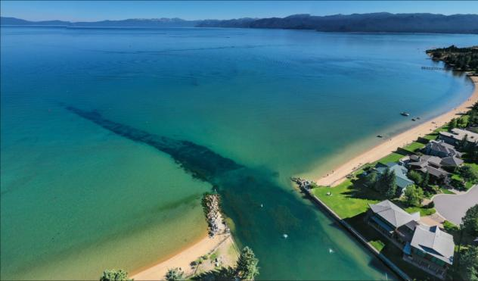
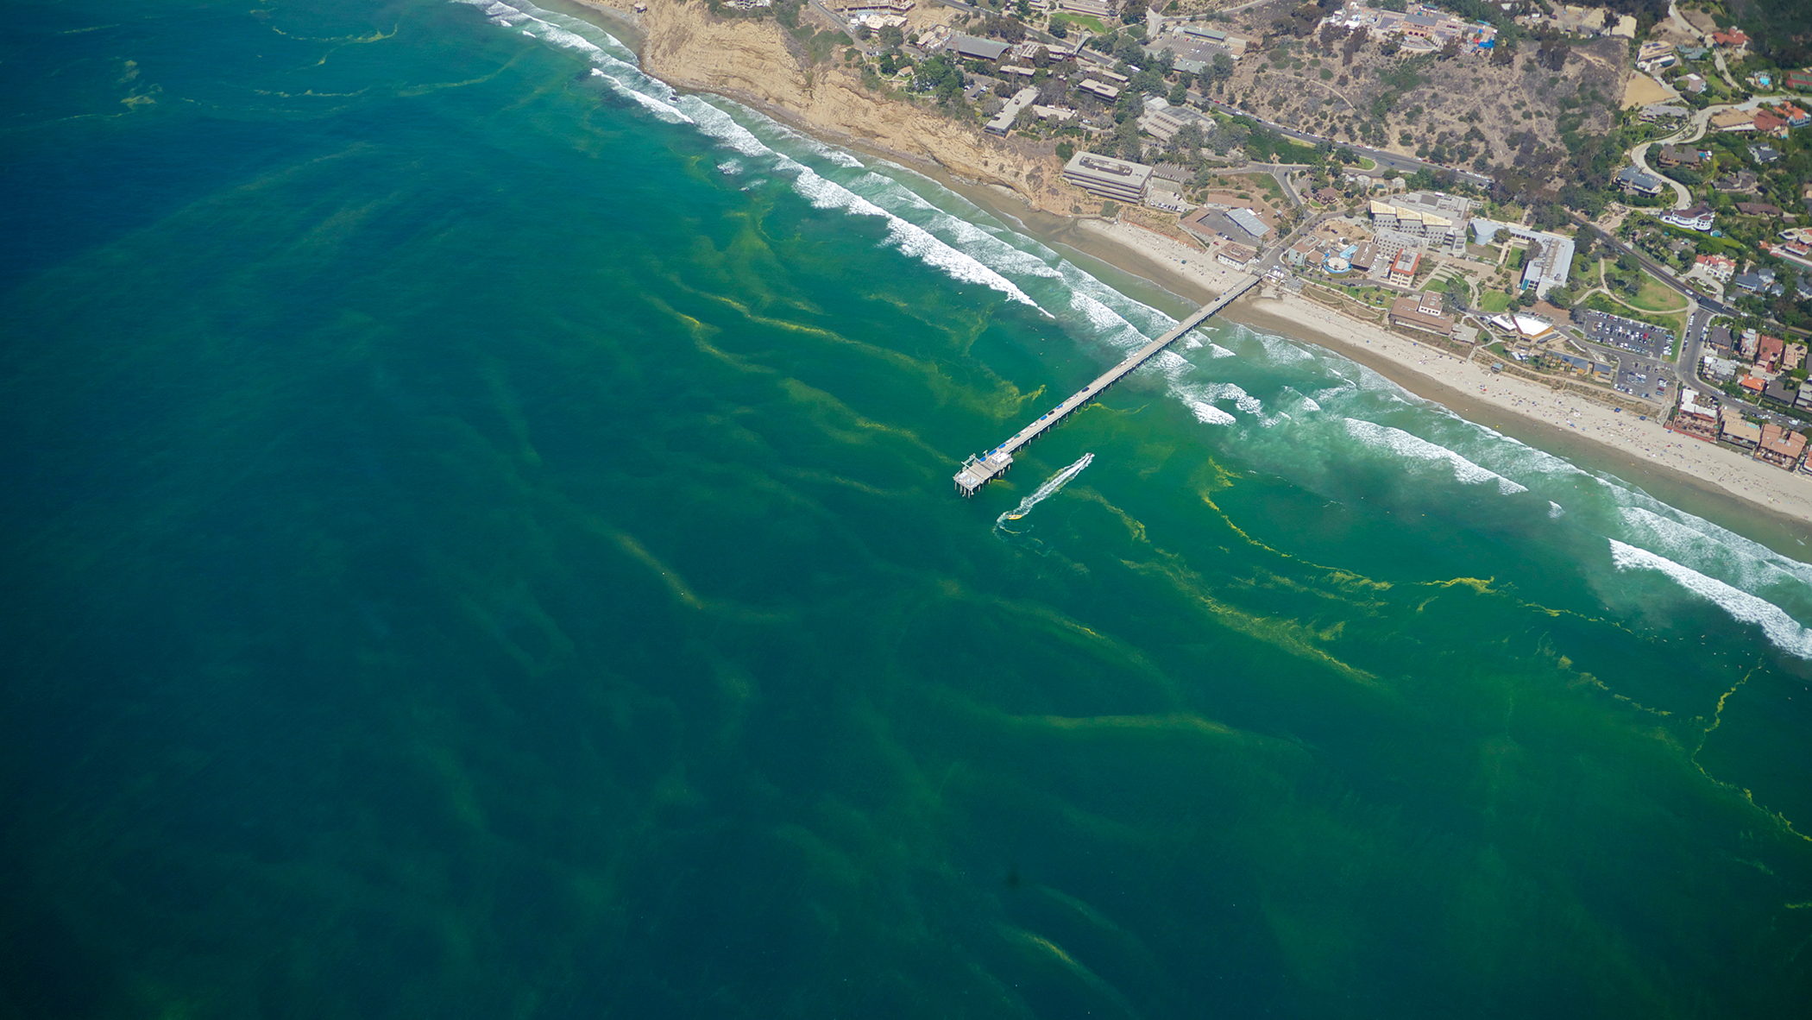
Development of a Predictive HAB Planning Tool using CE-QUAL-W2 Todd Steissberg (Todd.E.Steissberg@erdc.dren.mil, 530-574-5572), Jodi Ryder, Isaac Mudge, Lauren Melendez, Emily Summers
CE-QUAL-W2 Water Quality Capabilities
Longitudinal-vertical hydrodynamics and water quality in stratified and non-stratified systems
Multiple algae, epiphyton/periphyton, zooplankton, and macrophytes
Nutrients-dissolved oxygen-organic matter interactions
Vertical migration algorithms
Selective withdrawal from stratified reservoir outlets
Hypolimnetic aeration
Fish habitat
CBOD
Sediment diagenesis model
Generic water quality groups
Hydraulic structure algorithms
Dynamic shading algorithm based on topography and vegetation
ANSRP Harmful Algal Bloom Congressional Interest In-Progress Review

Slide 5
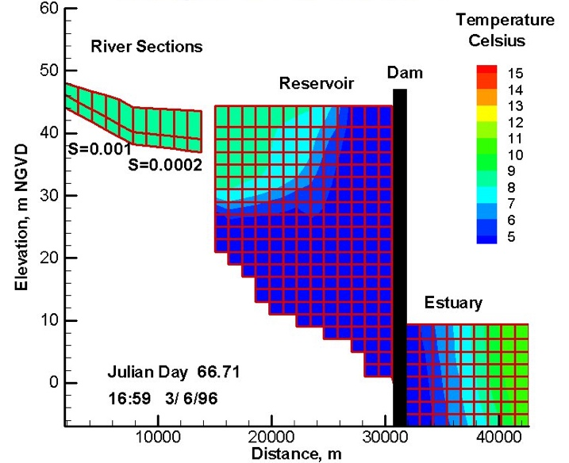
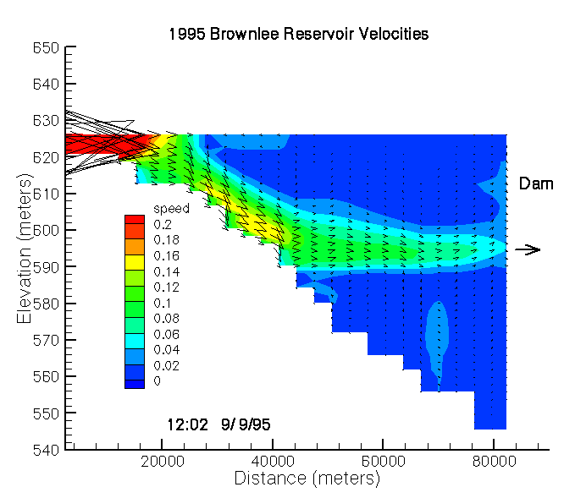
Development of a Predictive HAB Planning Tool using CE-QUAL-W2 Todd Steissberg (Todd.E.Steissberg@erdc.dren.mil, 530-574-5572), Jodi Ryder, Isaac Mudge, Lauren Melendez, Emily Summers
Ideal CE-QUAL-W2 Applications
Most reservoirs undergo vertical thermal stratification during spring and summer.
This stratification significantly affects water quality. Low dissolved oxygen concentrations often occur in the bottom of the water column (hypolimnion).
This leads to the formation of compounds, such as hydrogen sulfide, which are harmful to aquatic life and people.
The stratification also affects the hydrodynamics, including the vertical mixing of reservoirs, important for restoring dissolved oxygen to the hypolimnion.
CE-QUAL-W2 simulates these important hydrodynamic and water quality processes.
Reservoirs experience significant longitudinal water quality variability (gradients) due to pollution inflows and other factors. CE-QUAL-W2 simulates longitudinal and vertical dynamics and water quality changes through the reservoir system.
CE-QUAL-W2 assumes lateral homogeneity: it is best suited for longer and narrower waterbodies with longitudinal and vertical water quality gradients.
ANSRP Harmful Algal Bloom Congressional Interest In-Progress Review

Slide 6
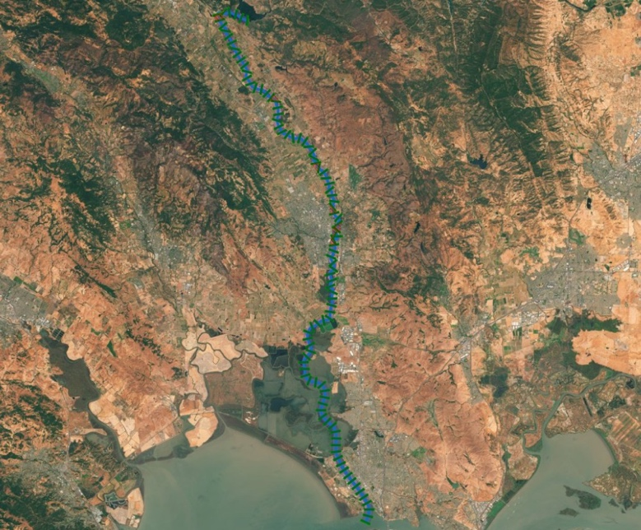
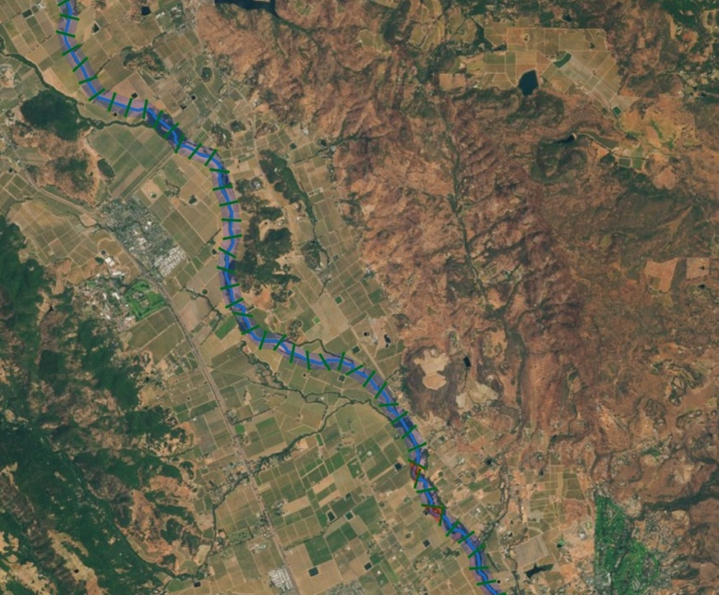
Development of a Predictive HAB Planning Tool using CE-QUAL-W2 Todd Steissberg (Todd.E.Steissberg@erdc.dren.mil, 530-574-5572), Jodi Ryder, Isaac Mudge, Lauren Melendez, Emily Summers
Past and Current Applications of CE-QUAL-W2
CE-QUAL-W2 is widely used by USACE and other federal, state, and local agencies for environmental impact assessments, planning studies, etc. Agencies with CE-QUAL-W2 as their standard reservoir water quality model:
U.S. Geological Survey (USGS)
U.S. Bureau of Reclamation
U.S. Environmental Protection Agency (EPA)
State of California
More than 1,100 model applications have been developed worldwide for reservoirs, rivers, estuaries, and other water bodies since CE-QUAL-W2’s release in 1986.
CE-QUAL-W2 is also used as a research tool by researchers at universities and other organizations.
At least 1,500 publications utilized or cited CE-QUAL-W2 in the year 2022.
Recent Studies:
Water Temperature Modeling Platform, California Central Valley Project (USBR and State of California): This platform applies CE-QUAL-W2 for ongoing and future operations decision-making
USACE Northwest Division, Columbia and Snake River Watershed
Columbia System Reservoir Operation (CRSO) Project
Columbia River Treaty (CRT) Project
Philadelphia District, Lehigh River Water Quality Modeling
ANSRP Harmful Algal Bloom Congressional Interest In-Progress Review

Slide 7
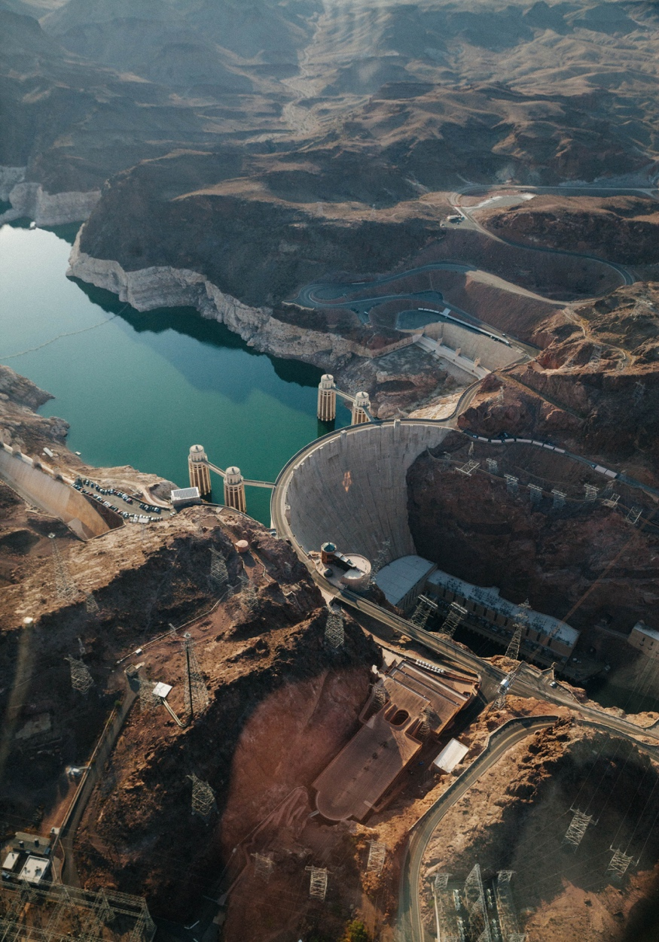
Development of a Predictive HAB Planning Tool using CE-QUAL-W2 Todd Steissberg (Todd.E.Steissberg@erdc.dren.mil, 530-574-5572), Jodi Ryder, Isaac Mudge, Lauren Melendez, Emily Summers
CE-QUAL-W2 Model Benefits
Since 1986, CE-QUAL-W2 has been used by water quality managers to assess impacts of management strategies on reservoir, lake, and estuarine systems.
CE-QUAL-W2 computes the two-dimensional velocity field for narrow systems that stratify.
In contrast with reservoir models with simplified hydrodynamics, CE-QUAL-W2 accurately simulates vertical and longitudinal transport of constituents, which can be as important as chemical kinetics in accurately simulating water quality.
Applications of CE-QUAL-W2 include:
Planning Studies
Environmental Impact Assessments
Ecosystem Restoration Projects
Real-Time Systems Operation and Decision-Making
ANSRP Harmful Algal Bloom Congressional Interest In-Progress Review

Slide 8

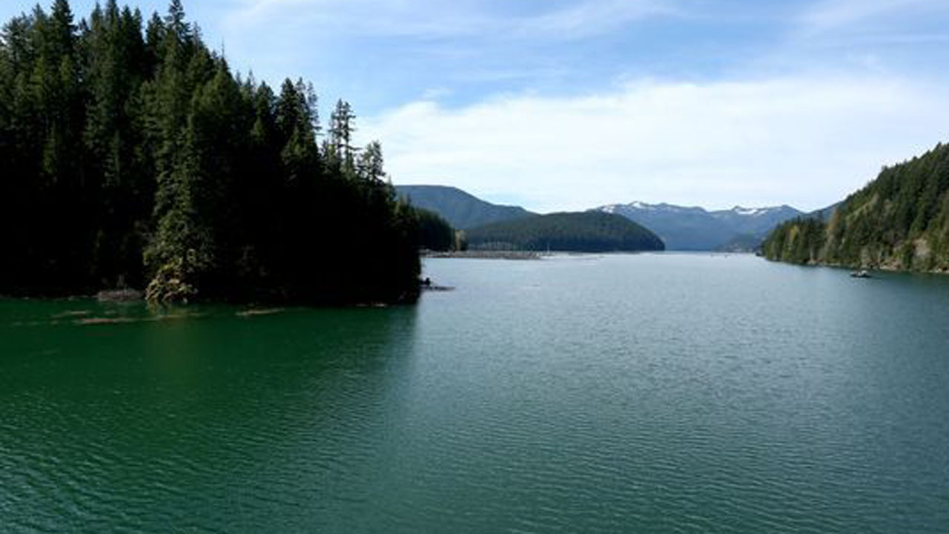
Development of a Predictive HAB Planning Tool using CE-QUAL-W2 Todd Steissberg (Todd.E.Steissberg@erdc.dren.mil, 530-574-5572), Jodi Ryder, Isaac Mudge, Lauren Melendez, Emily Summers
Challenges and Solutions
Developing HAB simulation capabilities applicable to any reservoir is challenging. Reservoirs have characteristics that can vary significantly:
Algal species
Water body morphometry (length, width, etc.)
Volume
Depth
Mixing dynamics (wind forcing, fetch orientation)
Harmful algal blooms can exhibit rapid changes and non-linear dynamics that are difficult to capture in model simulations.
To address these issues:
Extensive literature review. Feedback gathered from HAB experts.
Case study site (Detroit Lake) selected to provide adequate data and a range of conditions that enables development of scaling methods.
Single species selected for algorithm development. Will serve as a surrogate for prediction.
Detroit Reservoir, Oregon
Detroit Lake HAB
ANSRP Harmful Algal Bloom Congressional Interest In-Progress Review

Slide 9
Development of a Predictive HAB Planning Tool using CE-QUAL-W2 Todd Steissberg (Todd.E.Steissberg@erdc.dren.mil, 530-574-5572), Jodi Ryder, Isaac Mudge, Lauren Melendez, Emily Summers
Method and Algorithm Research
Upwelling and boundary mixing dynamics
HABs are not spatially uniform
They are controlled by light penetration, temperature, and nutrient availability
Investigate the role of boundary mixing and upwelling on light penetration and HAB growth
Relate vertical mixing to HAB occurrence and intensity
Nondimensional numbers: Schmidt Stability Index, Wedderburn Number, Richardson Number
CE-QUAL-W2 enhancements:
HAB species growth dynamics
Vertical diurnal migration
Nitrogen fixation algorithms (cyanobacteria may outcompete native algae since they can fix nitrogen)
Sub-grid modeling to capture lateral variability (post-processing tool)
Prediction tool:
Use CE-QUAL-W2 outputs and observed cross-sectional data to predict the maximum concentrations and locations of occurrence.
ANSRP Harmful Algal Bloom Congressional Interest In-Progress Review

